Slide 1


Sanjivani college of engineering
DEPARTMENT OF COMPUTER ENGINEERING
PROJECT NAME
RANSOMWARE DETECTION
GROUP MEMBERS
ROLL NO | NAME
68 | Gauri hole
75 | Aditi bairagi
76 | Ishwari kape
71 | Jagtap vidya
Guided By : Prof. Shivarkar S.A

Slide 2
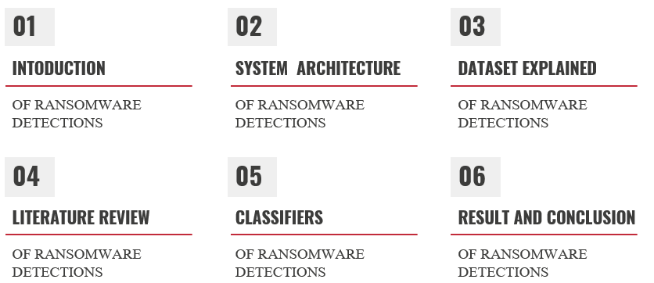
TABLE OF CONTENTS
Guided By : Prof. Shivarkar S.A

Slide 3

INTRODUCTION
Ransomware is a nasty computer program that locks up your important files and demands money (usually in cryptocurrency) for you to get them back. It's like a digital kidnapper for your data.
Imagine someone sneaking into your computer, grabbing all your important documents, photos, and spreadsheets, and then locking them away with a secret code. That's what ransomware does. It uses fancy encryption techniques to make your stuff unreadable unless you pay up.
Ransomware often sneaks into your computer through sneaky emails or other tricks. Once it's in, it starts hunting down all the stuff you care about—like your essays, family photos, or work projects—and locks them up tight.
There are two main types of ransomware: crypto ransomware and locker ransomware. Crypto ransomware goes after your files, while locker ransomware locks you out of your whole computer. They're both bad news.
Some of the most notorious ransomware gangs include names like Cryptowall, Locky, and WannaCry. They've caused a lot of trouble for all sorts of people and organizations, from big companies to regular folks like you and me.
So, it's important to be careful online and keep your computer protected with good security measures to avoid falling victim to these digital bullies

Slide 4

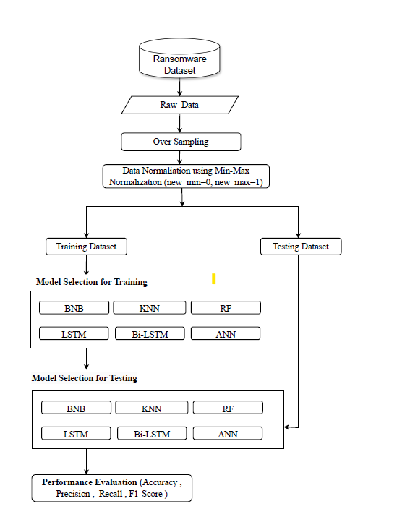
SYSTEM ARCHITECTURE

Slide 5

DATASET EXPLAINED
The dataset, named "dataset.txt," is a collection of information about ransomware, consisting of 24 attributes for each sample. These attributes include binary values, where "1" indicates the presence of a certain characteristic and "0" denotes its absence.
The final attribute, the 24th one, assigns a label to each sample, indicating which ransomware family it belongs to.
Each family, such as "benign," "cerber," "locky," and others, has a specific number of samples within the dataset. For instance, there are 438 samples of "benign" ransomware, 948 samples of "reveton," and so forth.
The purpose of utilizing this dataset is to classify different types of ransomware families. By analyzing the attributes present in each sample, researchers aim to train computer models to recognize patterns and accurately predict the family to which a new ransomware sample belongs.
Various tables and statistics are employed to analyze the dataset, facilitating the understanding of different ransomware families' characteristics and aiding in the development of effective tools to combat them.

Slide 6

LITERATURE
In recent research, several studies have delved into the realm of ransomware attacks, each focusing on distinct aspects of this pervasive cyber threat. Lena et al. (2020) explored the differential impacts of ransomware attacks on Small and Medium Enterprises (SMEs) and larger enterprises, investigating factors such as organizational size, sector, and the type of ransomware employed.
Their findings highlighted the severity of financial losses, data encryption impact, and operational disruptions incurred by organizations, shedding light on the nuanced dynamics of ransomware assaults. In a parallel effort, Aldauiji et al. (2019) delved into cybersecurity technologies like cyber threat hunting (CTH) and cyber threat intelligence (CTI), aiming to bolster organizations' defense mechanisms against ransomware.
They identified gaps in current CTH solutions and proposed integrating machine learning techniques for more effective threat detection. Similarly, Molina et al. (2021) undertook dynamic malware analysis to discern pre-attack behaviors of ransomware, employing various models and algorithms to dissect ransomware families' unique characteristics.
Their research underscored the importance of dynamic analysis and machine learning in enhancing detection accuracy, offering promising avenues for bolstering cybersecurity defenses against ransomware threats. Together, these studies provide valuable insights into the multifaceted nature of ransomware attacks and offer strategies for mitigating their detrimental effects on organizations and individuals alike.

Slide 7

CLASSIFIERS
Random Forest (RF): RF is an ensemble learning method that constructs a multitude of decision trees during training and outputs the mode of the classes (classification) or the mean prediction (regression) of the individual trees. It's known for its robustness and accuracy in handling large datasets with high dimensionality.
K-Nearest Neighbors (KNN): KNN is a simple and intuitive classification algorithm that works based on the similarity of input data points. It assigns a class label to a new data point based on the majority class among its k nearest neighbors in the feature space.
Bernoulli Naive Bayes (BNB): BNB is a variant of the Naive Bayes algorithm that is specifically designed for binary feature vectors. It assumes that the presence of a particular feature in a class is unrelated to the presence of any other feature.
Artificial Neural Networks (ANN): ANN is a computational model inspired by the structure and function of the human brain. It consists of interconnected nodes organized in layers, including input, hidden, and output layers. ANN is capable of learning complex patterns and relationships in data through training.
Long Short-Term Memory (LSTM): LSTM is a type of recurrent neural network (RNN) architecture designed to overcome the limitations of traditional RNNs in capturing long-range dependencies in sequential data. It is widely used in tasks involving time series data and natural language processing.

Slide 8

CLASSIFIERS
Bidirectional LSTM (BI-LSTM): BI-LSTM is an extension of LSTM that processes input sequences in both forward and backward directions. This enables the model to capture contextual information from both past and future inputs, making it particularly effective for tasks requiring understanding of temporal relationships.
Support Vector Machine (SVM): SVM is a supervised learning algorithm that is used for classification and regression tasks. It finds the optimal hyperplane that best separates data points of different classes in a high-dimensional space. SVM is effective in handling both linearly separable and non-linearly separable data.
Decision Trees (DT): DT is a simple yet powerful algorithm for classification and regression tasks. It builds a tree-like structure where each internal node represents a decision based on a feature attribute, and each leaf node represents a class label or a numerical value. DTs are easy to interpret and understand, making them popular for decision-making tasks.
These algorithms offer diverse approaches to solving the ransomware family classification problem, each with its strengths and weaknesses. Depending on the specific characteristics of the dataset and the nature of the problem, different algorithms may perform better than others.

Slide 9

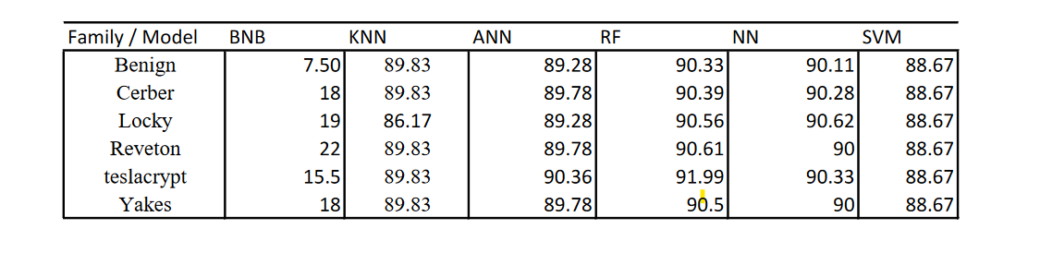
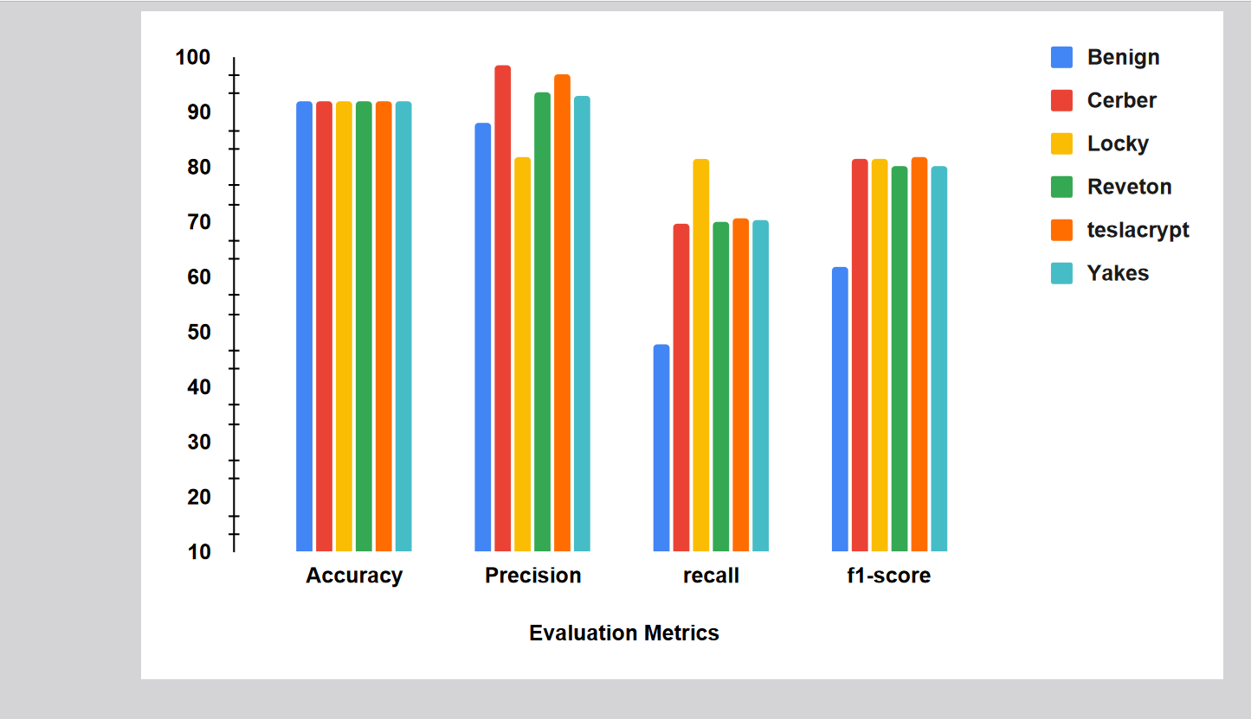

RESULT ANALYSIS
K-fold Average Accuracy Analysis of Ransomware Families

Slide 10
RESULT ANALYSIS
The study conducted a comprehensive evaluation of various machine learning algorithms for the classification of ransomware families, utilizing a dataset comprising over 3,000 samples from six predominant families. Among the algorithms examined, the Random Forest (RF) model exhibited the highest accuracy, achieving an impressive 92.01%. Following closely behind were Decision Trees (DT) at 91.51% and Neural Networks (ANN) at 91.11%. This analysis underscores RF's effectiveness in accurately categorizing ransomware families based on behavioral characteristics.
Additionally, the study employed k-fold cross-validation to determine the optimal training and testing split. Results indicated that a 90:20 split, allocating 90% of the data for training and 20% for testing, yielded the highest accuracy across most models. This finding suggests the importance of data allocation in achieving optimal performance in classification tasks.
Looking ahead, the study proposes incorporating additional supervised classification algorithms to further enhance accuracy. By diversifying the range of algorithms used, researchers aim to improve precision and accuracy in identifying ransomware families, thereby bolstering cybersecurity defenses against such threats.
Overall, the research contributes valuable insights into ransomware behavior and classification techniques. By leveraging dynamic analysis and machine learning methodologies, the study advances our understanding of ransomware detection and mitigation strategies, paving the way for more robust cybersecurity frameworks in the future.

Slide 11

CONCLUSION
In conclusion, our study demonstrates the effectiveness of utilizing machine learning algorithms, particularly Random Forest, Decision Trees, and Neural Networks, in classifying ransomware families based on behavioral characteristics.
With an accuracy rate of 92.01%, Random Forest emerged as the top-performing algorithm among the ones tested. K-fold cross-validation revealed that a 90:20 training and testing split yielded optimal accuracy across most models.
Moving forward, incorporating additional supervised classification algorithms could further enhance precision and accuracy in ransomware classification
.Overall, our research provides valuable insights into ransomware detection and underscores the importance of dynamic analysis in monitoring ransomware behavior in real-time.

Slide 12
Thanks!
Do you have any questions?

